Slide 1
Local Search
Course : COMP6065001 Artificial Intelligence
Effective Period : September 2023
Session 3

Slide 2
Learning Outcome
At the end of this session, students will be able to:
LO 1: Describe what is AI and identify concept of intelligent agent
LO 2: Explain various intelligent search algorithms to solve the problems

Slide 3
Outline
Computational Optimization Techniques
Local Search
Hill Climbing
Exercise

Slide 4
Introduction
In standard algorithmic theory, the burden of designing an efficient algorithm for solving a problem at hand is on the algorithm designer.
In the decades since in the introduction of computer science, elegant algorithms have been designed for tasks ranging from finding the shortest path in a graph, computing the optimal flow in a network, compressing a computer file containing an image captured by digital camera, and replacing a string in a text document.
The mathematical optimization approach to machine learning is to view the process of machine training as an optimization problem

Slide 5
Computational Optimization Techniques
Optimization
Convex Programming
Iterative Methods
Heuristic
Linear Programming
Newton’s Method
Local Search: Hill Climbing
Quadratic Programming
Gradient Descent
Genetic Algorithm
Etc
etc
etc

Slide 6
Local Search
Local search algorithms operate using a single current node (rather than multiple paths) and generally move only to neighbors of that node.
Typically, the paths followed by the search are not retained.
Local search has two advantages
They use very little memory
They can often find reasonable solutions in large or infinite (continuous) state spaces

Slide 7
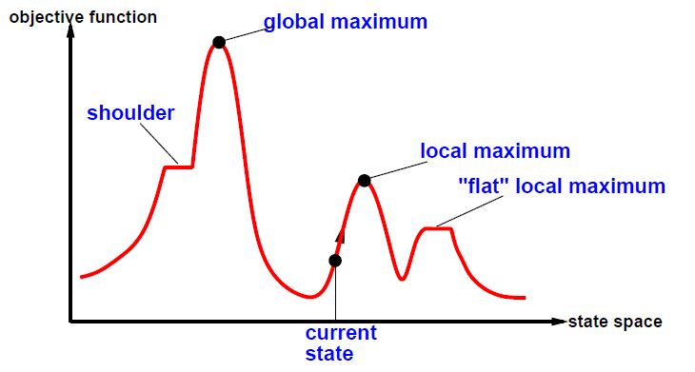
Local Search
Local search algorithms are useful for solving pure optimization problems
To find a best state according to an objecting function

Slide 8
Local Search
The aim of the optimization algorithm is to find the highest peak (global maximum)

Slide 9
Local Search
A complete algorithm always finds a goal if it exists
An optimal algorithm always finds the global maximum/minimum

Slide 10
Hill Climbing
It is simply that continually moves in the direction of increasing value (uphill)
It terminates when it reaches a “peak” where no neighbor has a higher value
It starts with a random (potentially poor) solution, and iteratively makes small changes to the solution, each time improving it a little.

Slide 11
Hill Climbing
All successors of a node are evaluated and the one that give the most improvement is selected
Choose the successor with the best solution
Highest-valued = best solution
Hill-climbing is like “climbing a mountain without compass”

Slide 12
Hill Climbing
Example
1 | 2 | 3
4 |  | 6
7 | 5 | 8
Start state
h(x) = 2
1 |  | 3
4 | 2 | 6
7 | 5 | 8
1 | 2 | 3
 | 4 | 6
7 | 5 | 8
1 | 2 | 3
4 | 5 | 6
7 |  | 8
1 | 2 | 3
4 | 6
7 | 5 | 8
h(x) = 3
h(x) = 3
h(x) = 1
h(x) = 3
1 | 2 | 3
4 | 5 | 6
7 | 8
Goal state
h(x) = 0

Slide 13
Problems in Hill Climbing
Hill Climbing search often get stuck due to the following conditions:
Local maxima, ridges, and plateaux

Slide 14
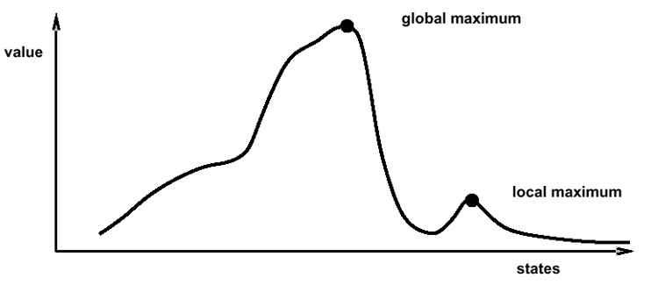
Problems in Hill Climbing
Local maxima/minima
A peak that is higher than each of its neighboring states but lower than the global maximum.

Slide 15

Problems in Hill Climbing
Ridges (Sequence of local maxima)
It is very difficult for greedy algorithms to navigate

Slide 16
Problems in Hill Climbing
Plateaux
A flat area of the state-space landscape
It can be a flat local maximum or a shoulder
?
Not Difference ?

Slide 17
Problems in Hill Climbing
Ways Out
Backtrack to some earlier node and try going in a different direction.
Make a big jump to try to get in a new section.
Moving in several directions at once.

Slide 18
Exercise
1 | 2 | 3
7 | 8 | 4
6 |  | 5
1 | 2 | 3
8 |  | 4
7 | 6 | 5
Initial States
Goal States
Using Hill Climbing algorithm to find Goal states from initial States

Slide 19
References
Stuart Russell, Peter Norvig. 2010. Artificial Intelligence : A Modern Approach. Pearson Education. New Jersey. ISBN:9780132071482
Local Search: https://courses.edx.org/asset-v1:ColumbiaX+CSMM.101x+2T2017_2+type@asset+block@AI_edx_SearchAgents_Local.pdf
Elad Hazan, Lecturer Note: Optimization for Machine Learning. https://arxiv.org/pdf/1909.03550.pdf

